Slide 1

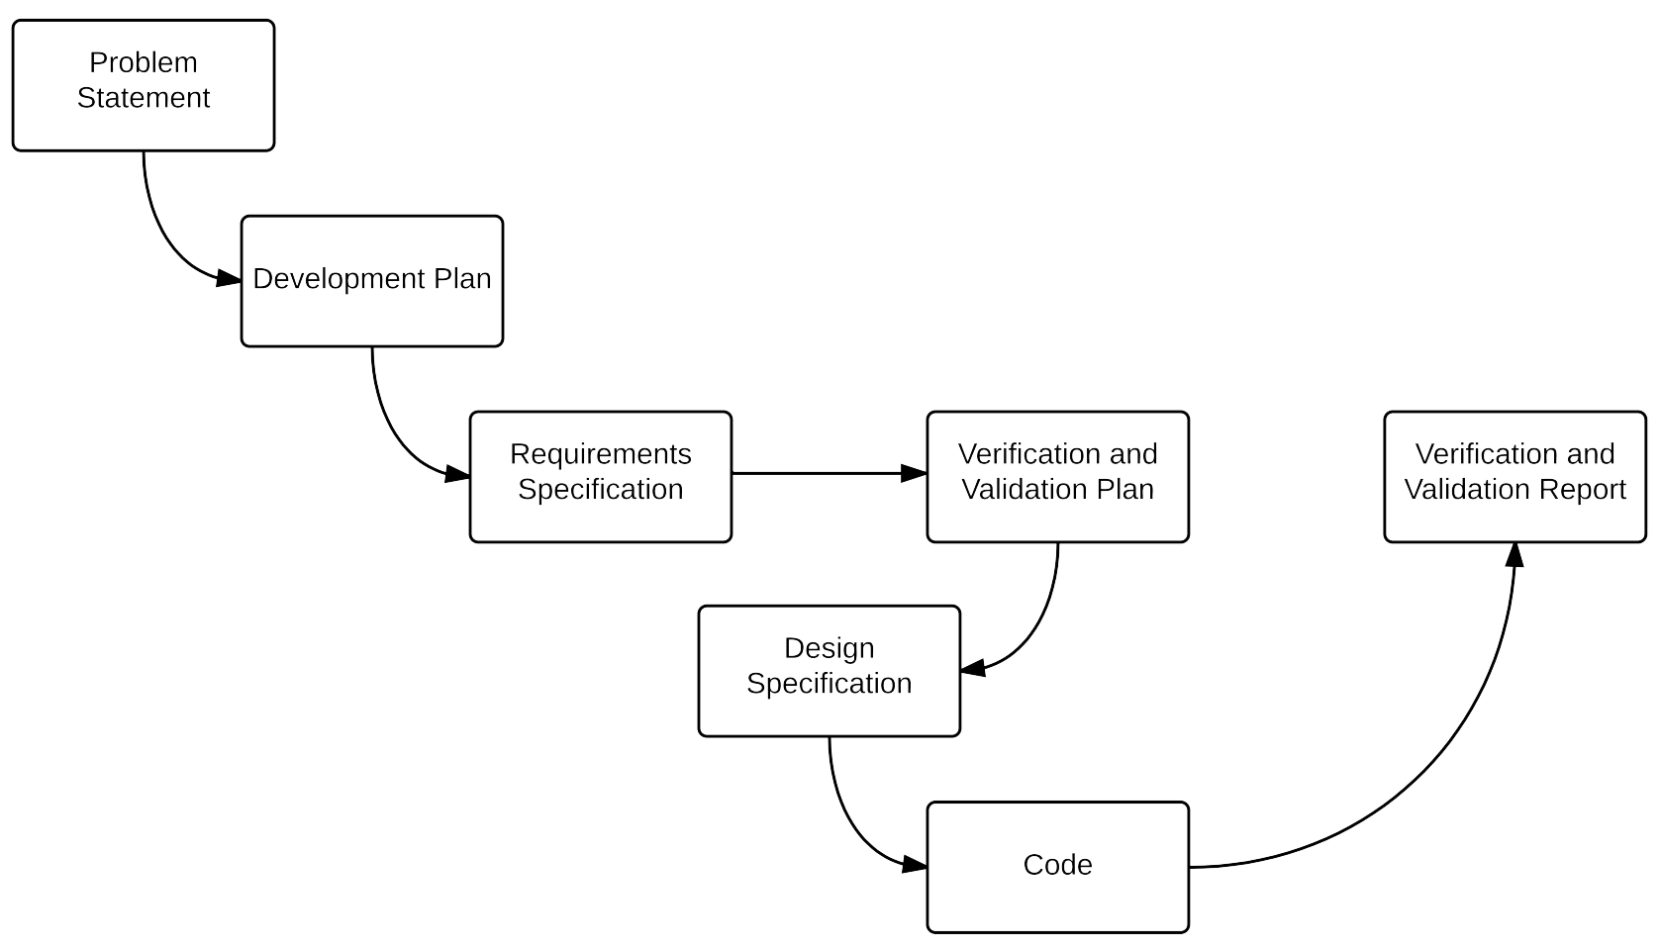
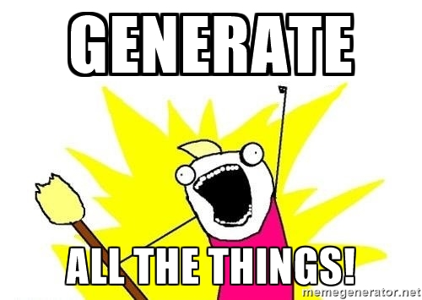
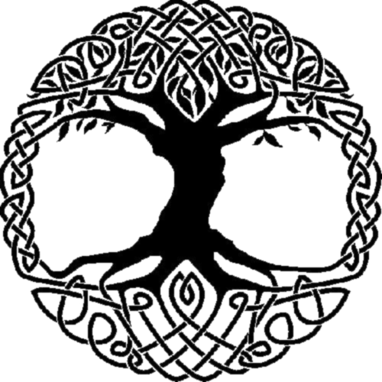
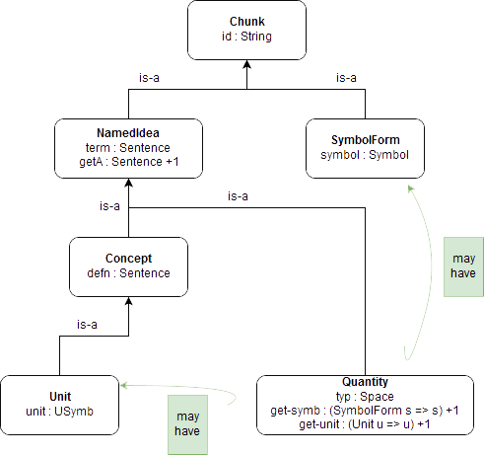
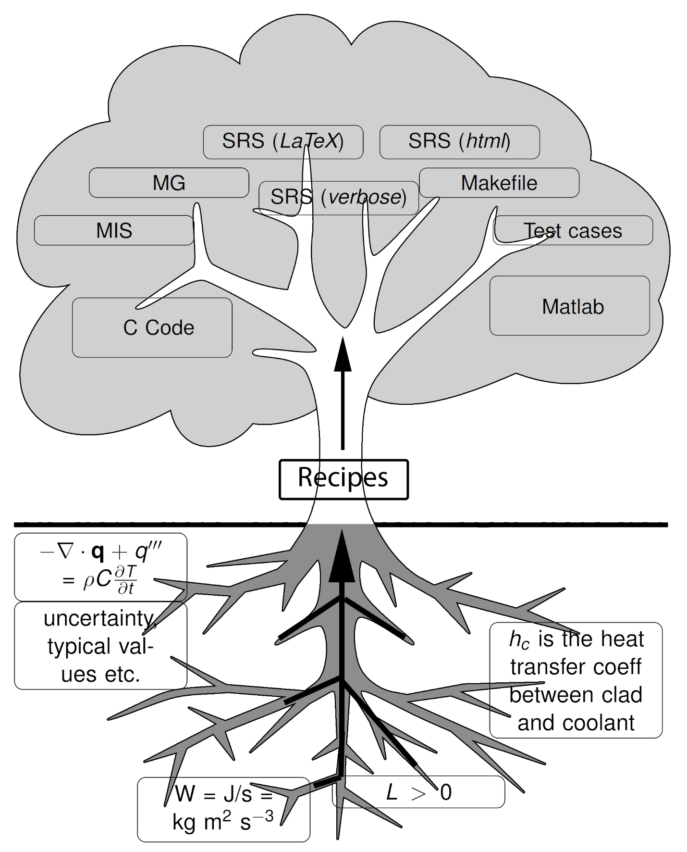
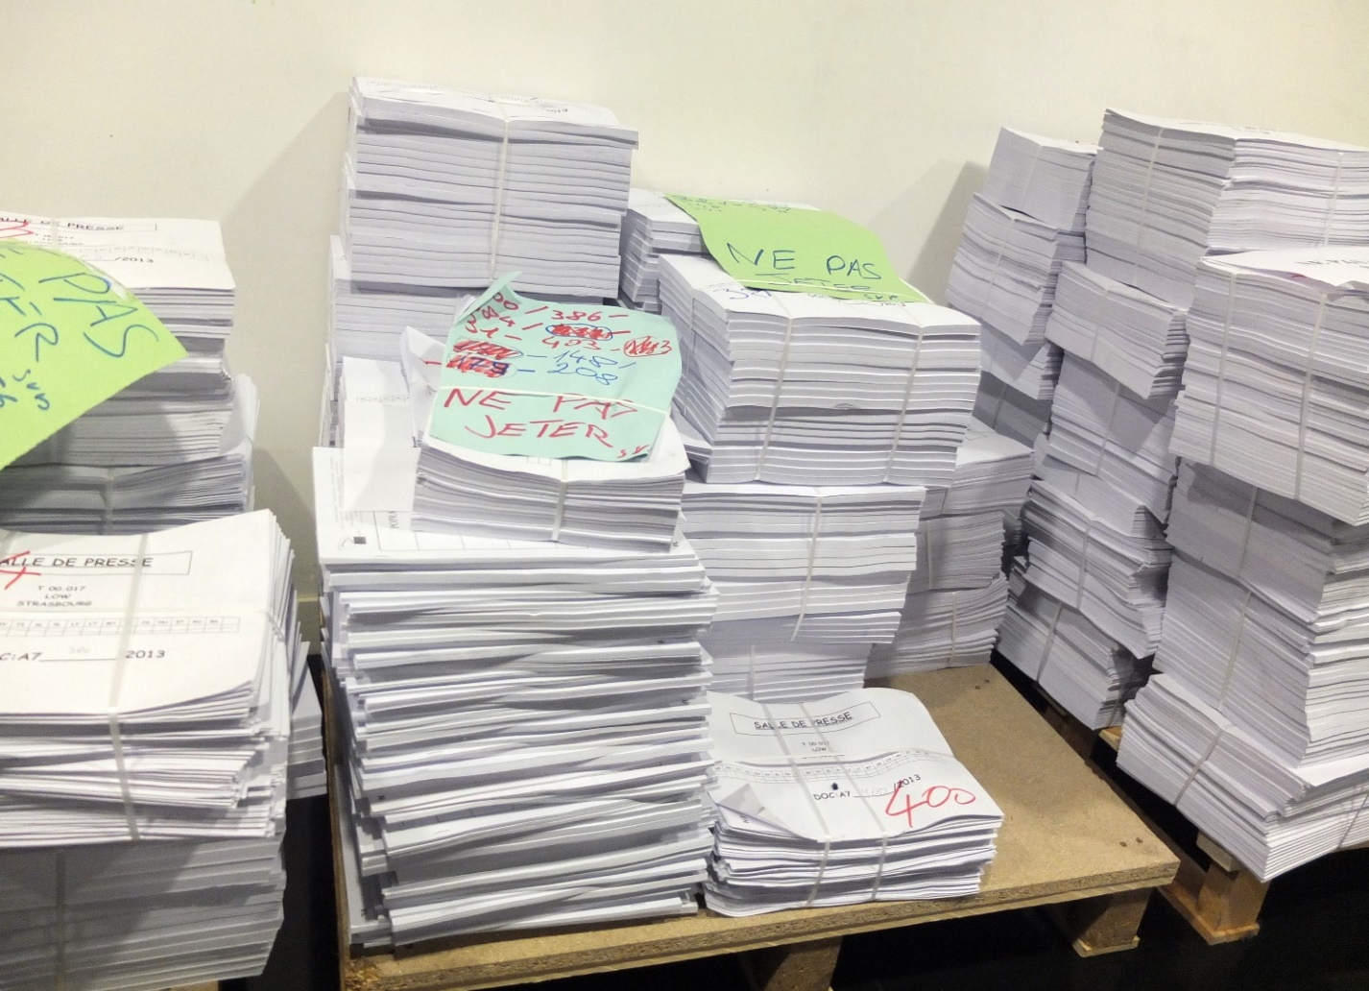
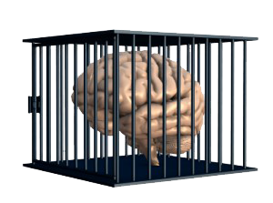
 | Drasil: A Framework for Literate Scientific Software Dan Szymczak, Steven Palmer, Jacques Carette, Spencer Smith Department of Computing and Software, McMaster University
Sick of out of sync Software Artifacts? Research Problem Software artifacts contain a vast amount of knowledge duplication and transformation. A single piece of underlying knowledge should appear (in some form) in every artifact for a given piece of software. In certain domains, like Scientific Computing, knowledge is duplicated across many different pieces of software. This duplication is almost exclusively performed manually, whether by copying/pasting from existing artifacts, or by transcription from another source such as a textbook. Artifacts tend to fall out of sync as the software is updated (especially code versus documentation), negatively impacting the overall software quality. This is most noticeable when it comes to maintainability, traceability, and verifiability. Contact Dan Szymczak: szymczdm@mcmaster.ca | Introduction Rational Design Process Leads to higher quality software (Parnas & Clements 1986) Tedious so ignored by many Scientific Computing (SC) developers (Kelly 2007) Necessary for certification Why not automate it? Goals/Contributions The Drasil Framework Knowledge-based approach to SC Software Development Knowledge Capture Simplifying Software (Re)Certification | Approach From Abstract Theories to Artifacts Create a graph of the Abstract Theory Obtain a graph of Instances by applying design choices to the Abstract Theory graph Obtain a graph of the Executable Specification by applying execution choices Translate the Executable Specification to modules of Abstract Code Render the final output Note: Identifying the abstract theory and design/execution choices is a difficult process requiring the assistance of domain experts. Drasil is being developed through rapid iteration using a practical, example-driven approach Drasil is composed of a number of Domain-Specific Languages (DSLs) embedded in Haskell | Knowledge Capture Creating a knowledge base is central to the entire approach Knowledge is stored in Chunks and woven into software artifacts through Recipes (programs written using the DSLs) Complex chunks are built off simpler ones (Figure 4) Results Code Generation Incorporation of GOOL allows Drasil to generate output in a number of programming languages including: Document Generation Drasil currently outputs documents to TeX and HTML formats. Our abstract recipes allow us to change formats on the fly, or produce versions in multiple formats simultaneously. Disadvantages High initial time investment Adding knowledge is not simple; it requires domain experts Advantages Internal consistency: necessary for (re)certification Common knowledge base promotes reuse; can be shared across many projects Pervasive bugs: much easier to find and fix
Figure 1: A rational design process
Figure 4: Chunk Hierarchy
C++
C#
Java
Lua
Objective C
Python
Figure 3: Our Knowledge-Based Approach – Recipes collect and transform knowledge into Software Artifacts
Figure 2: Knowledge Capture is necessary with Drasil

